Slide 1
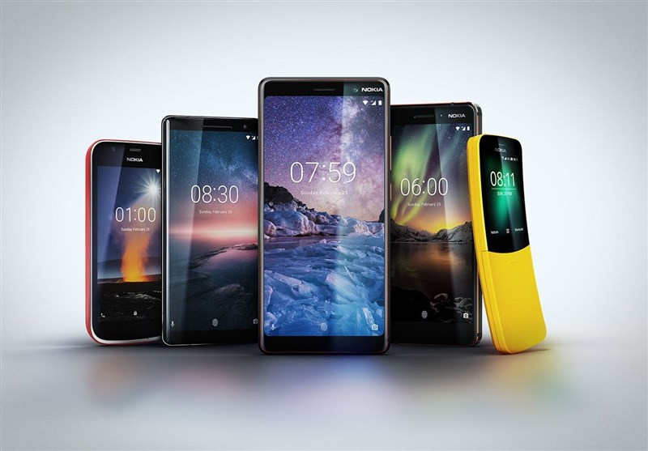
FEATURE EXTRACTION & MOBILE PRICE PREDICTION
USING MACHINE LEARNING
Presented By – Priyanka Verma
This Photo by Unknown Author is licensed under CC BY

Slide 2

What is Machine Learning ?
“Machine Learning is a branch of Artificial Intelligence that enables Algorithms to uncover hidden patterns within datasets, allowing them to make Predictions on new ,similar data without explicit programming for each task.”
This Photo by Unknown Author is licensed under CC BY

Slide 3
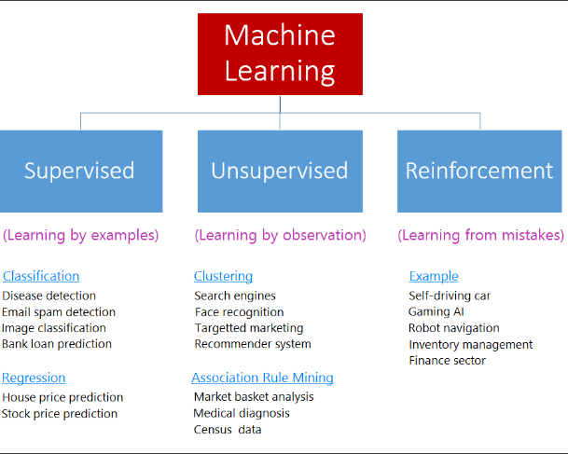
Types Of Machine Learning
Which Machine Learning type is used for our project MOBILE PRICE PREDICTON.
It is Supervised MACHINE LEARNING‘S second type “Regression ‘’ is best fit to achieve our goal Mobile price prediction Model using Regression ALGORITHMS.

Slide 4

Problem ststement for project “Feature Extraction and Price Prediction for Mobile Phones”
GOAL OF PROJECT
An organization is knee to enhance its pricing strategy by gaining a deeper understanding of the key features that influence the prices of mobile phones in today’s highly competitive market through build a predictive model that can accurately estimate the price of a mobile phone based on Features.

Slide 5
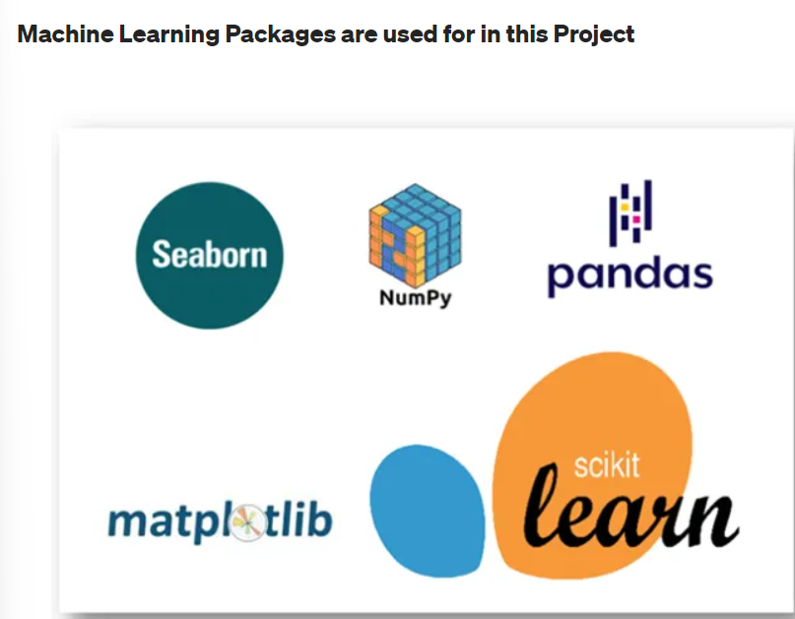

Slide 6
FLOW CHART TO ACHIEVE A GOAL OF PROJECT
DATA OVERVIEW AND EXPLORATION
DATA PREPROCESSING
FEATUER EXTRACTION
MODEL BUILDING AND EVALUATION
FEATUER IMPORTANCE ANALYSIS
REPORT AND VISUALIZATION
RECOMMENDATIONS

Slide 7
DATA OVERVIEW AND DATA EXPLORATION
DATA OVERVIEW
Dataset is supervised.
Dataset is provided in a excel file.
Dataset having 12 features and 451 rows.
Goggle colab and jupyter notebook gives the best environment to work on it .
DATA EXPLORATION
# Using Pandas we can read this Dataset.
df=pd.read_excel("/content/drive/MyDrive/Processed_Flipdata.xlsx")
df.hesd()
df.shape (541,12)
df.columns
Df.index
df.dtypes

Slide 8
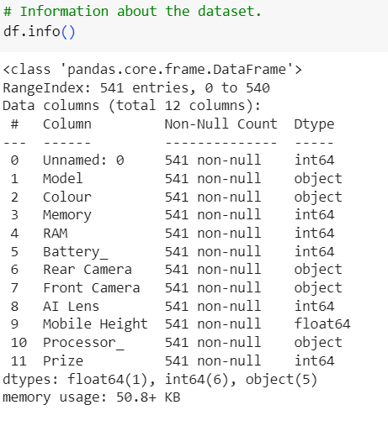
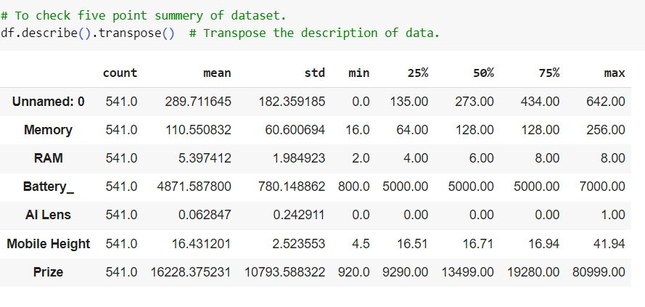
DATA OBSERVATIONS

Slide 9
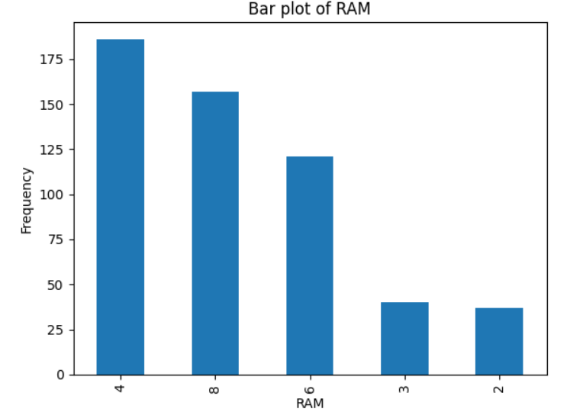
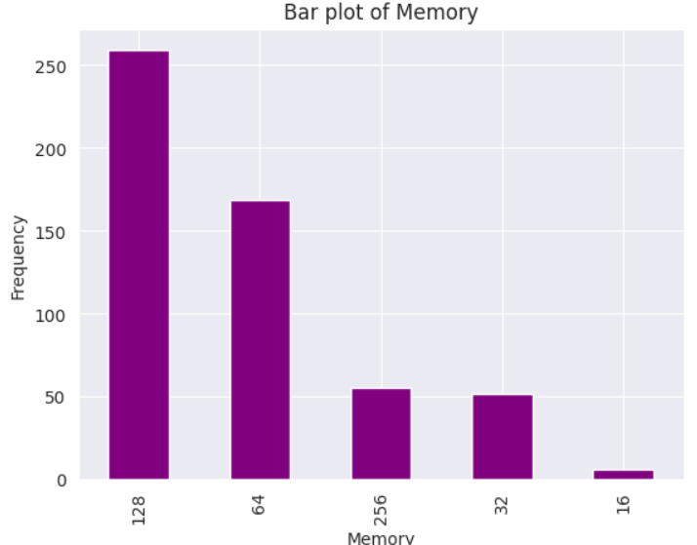
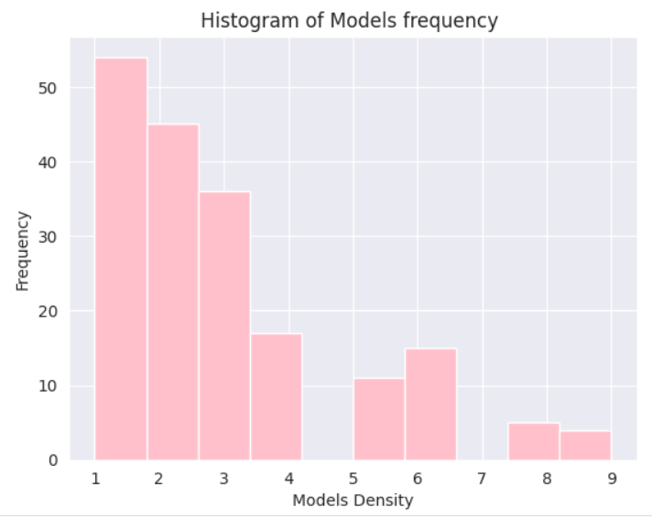
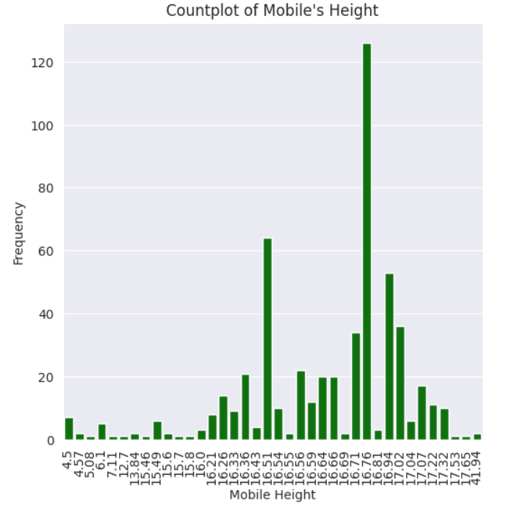
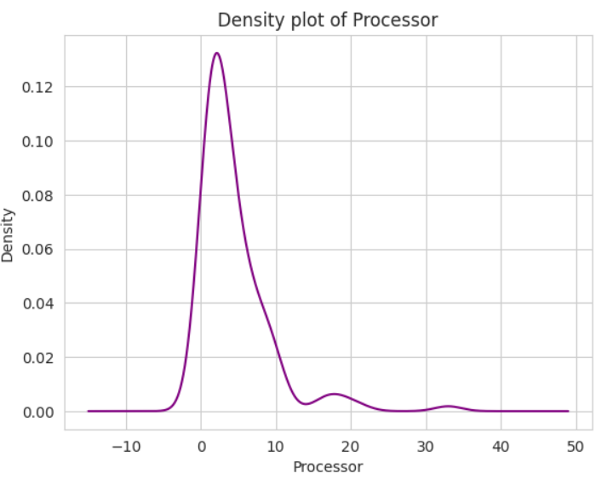
FEATUER EXTRACTION USING DATA VISUALIZATION
Bar plot of RAM show the 4GB and 260 GB Memory Frequency is most.
Similarly mobile phones height 16.75 is mostly present.
Here is histogram of models of phones
Kde plot of processors

Slide 10
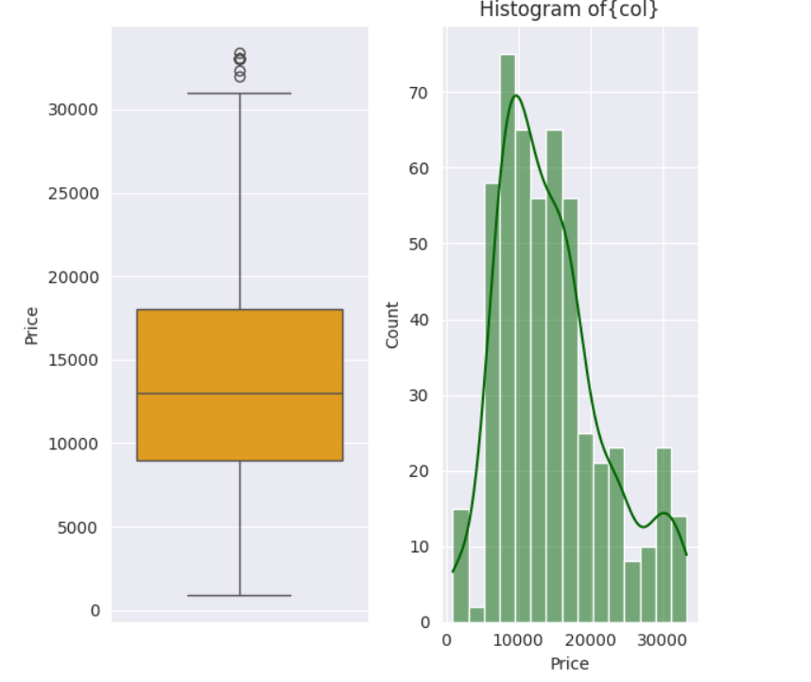
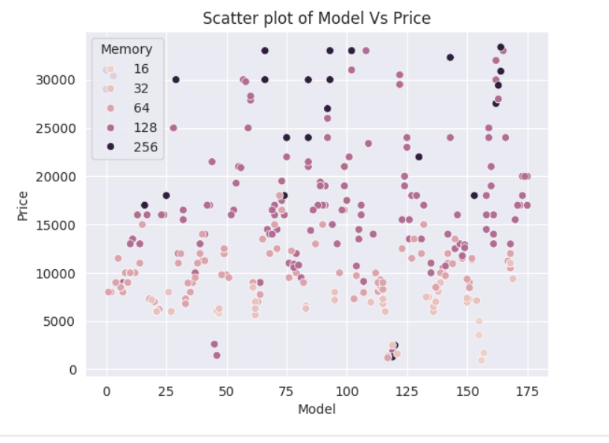
About Selling Price
There is some PLOTS for showing trends of Prices of MOBILE PHONES like Boxplot, after removing an outliers another one is Hstogram also shows the maximum selling prices are between the 10000 to 18000.
Second one plot is SCATTER PLOT between Price and models of phones with another parameter of Memory
Here I find out 256 GB memory required is mostly but it is mostly available in between 18000 to 30000 and more prices.

Slide 11
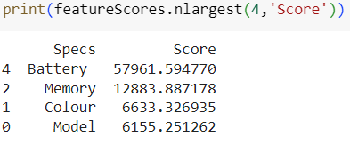
Handling Categorical Featuers(df_cat) , Using Label Encoder
import pandas as pd
from sklearn.preprocessing import LabelEncoder
# Initialize LabelEncoder
label_encoder = LabelEncoder()
label_encoder
for column in df_cat:
Mobile_data[column] = label_encoder.fit_transform(Mobile_data[column])
FEATUER SELECTION BY SELECT K BEST
from sklearn.feature_selection import SelectKBest
from sklearn.feature_selection import chi2

Slide 12
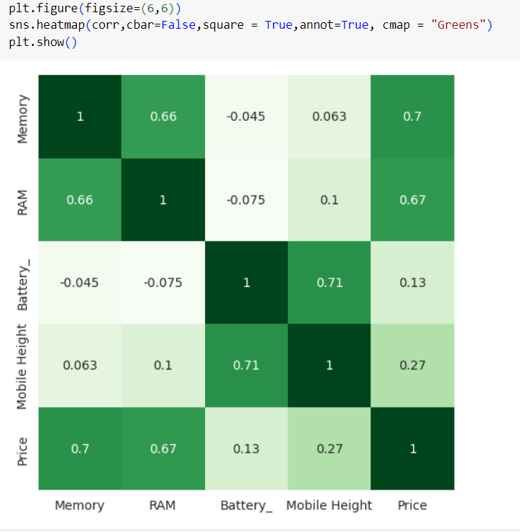
Correlation with key
features
According to above correlation with 'PRICE' we can say that Memory ,RAM, Mobile Height , Model ,Battery ,Rear camera then Color are highly correlated to the price of Mobile Phones and Processor, Front Camera are highly negatively correlated to the prices.

Slide 13
Feature importance :-
from sklearn.ensemble import ExtraTreesRegressor
import matplotlib.pyplot as plt
model = ExtraTreesRegressor()
model.fit(X,y)
Split the data into X and y :-
from sklearn.model_selection import train_test_split
X_train, X_test, y_train, y_test = train_test_split(X, y, test_size=0.2,random_state=42)
MODEL BUILDING :-
from sklearn.linear_model import LinearRegression
from sklearn.ensemble import RandomForestRegressor
from sklearn.svm import SVR

Slide 14
EVALUATION AFTER MODEL BUILDING
Training and testing Score/Accuracy of Linear Regression
Training Accuracy 0.6453402057430773
Testing Accuracy 0.6488705136787472
Training and testing Score/Accuracy of RandomForestRegression
Training Accuracy: 98.9758157285013
Testing Accuracy: 94.48962805497023
Training and testing Score/Accuracy of SupportVectorMachine
Training Accuracy: -6.8309854334640985
Testing Accuracy: -0.15013935867878025

Slide 15
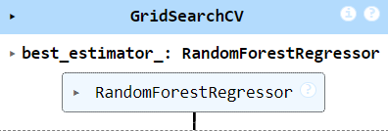
Cross validation and Hyperparameter Tuning
Cross Validation
Linear Regression has an r2 score:0.597,and SD:0.0794
Random Forest Regressor has an r2 score:0.943,and SD:0.023
Support Vector Regressor has an r2 score:-0.047,and SD:0.0461
Hypermarameter Tuning
from sklearn.model_selection import GridSearchCV
from sklearn.ensemble import RandomForestRegressor

Slide 16


